Slide 1
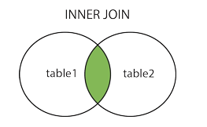
SQL INNER JOIN
The INNER JOIN keyword selects records that have matching values in both tables.
INNER JOIN Syntax
SELECT column_name(s) FROM table1 INNER JOIN table2 ON table1.column_name = table2.column_name;

Slide 2
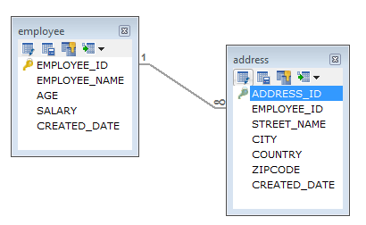
SQL INNER JOIN
In a one-to-many relationship, one record in a table can be associated with one or more records in another table.

Slide 3
SQL INNER JOIN
A JOIN clause is used to combine rows from two or more tables, based on a related column between them.
Employee
EMPLOYEE_ID | EMPLOYEE_NAME | AGE | SALARY | CREATED_DATE
1 | Peter | 32 | 7000 | 2019-09-03
2 | Dave | 34 | 8000 | 2019-09-04
3 | John | 45 | 10000 | 2019-09-24
Address
ADDRESS_ID | EMPLOYEE_ID | STREET_NAME | CITY | COUNTRY | ZIPCODE | CREATED_DATE
1 | 1 | 18,Dark Street | Chennai | India | 680009 | 2019-09-10
2 | 1 | 90,West Street | Bangalore | India | 655556 | 2019-09-18
3 | 2 | 898,East Street | Bangalore | India | 565565 | 2019-09-14
4 | 2 | 676,North Street | Chennai | India | 767676 | 2019-09-18
5 | 2 | 434,Good Street | Kerala | India | 656565 | 2019-09-16

Slide 4
SQL INNER JOIN
INNER JOIN Example
SELECT employee.EMPLOYEE_ID,employee.EMPLOYEE_NAME,address.CITY
FROM employee
INNER JOIN address ON employee.EMPLOYEE_ID=address.EMPLOYEE_ID;

